Slide 1
8.3.3 ANALYTICAL CHARACTERIZATION OF THE PUT PRICE
指導教授： 戴 天 時
學 生：王 薇 婷

Slide 2
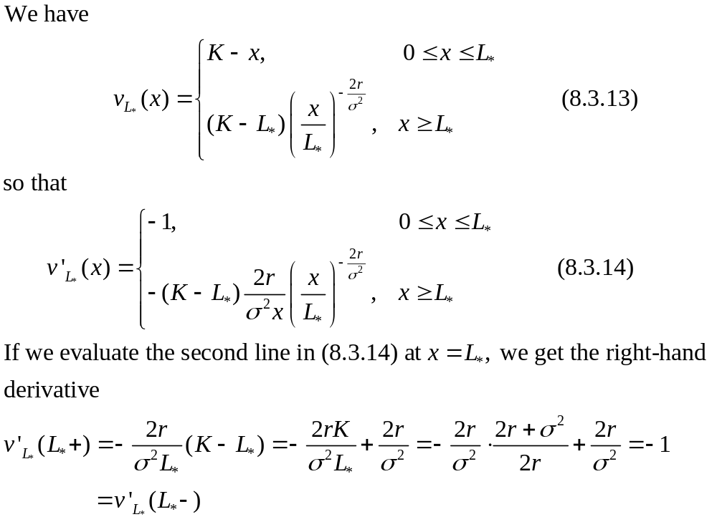

Slide 3
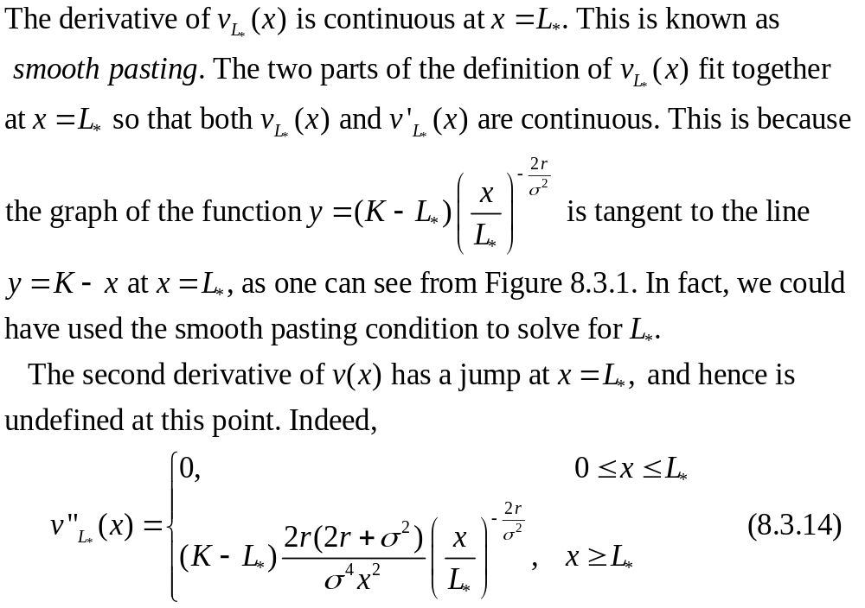

Slide 4
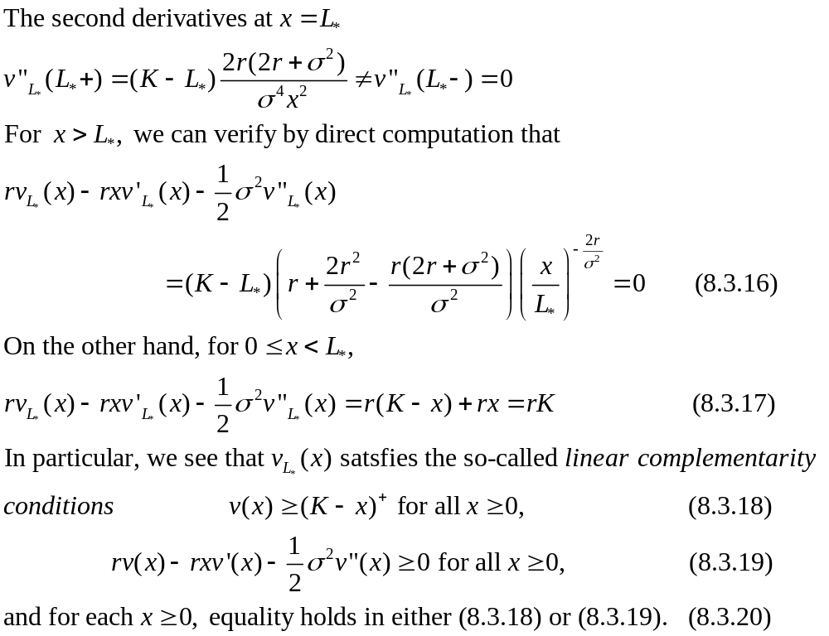

Slide 5
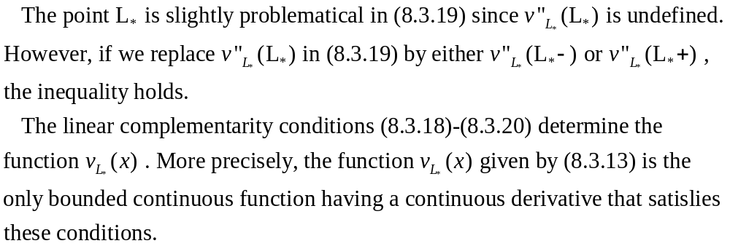

Slide 6
8.3.4 PROBABILISTIC CHARACTERIZATION OF THE PUT PRICE

Slide 7
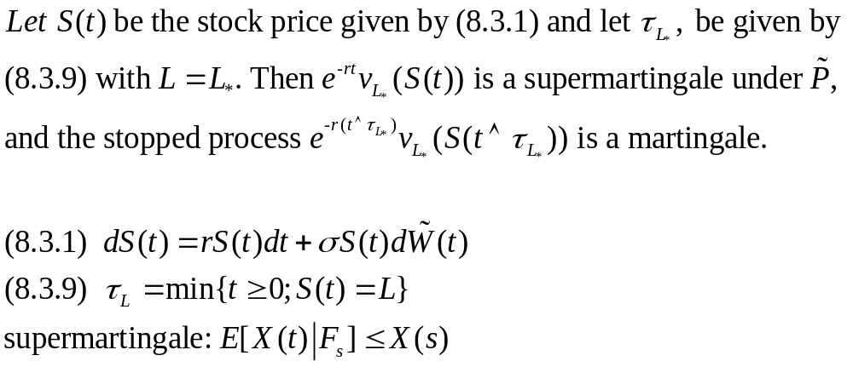
THEOREM 8.3.5

Slide 8
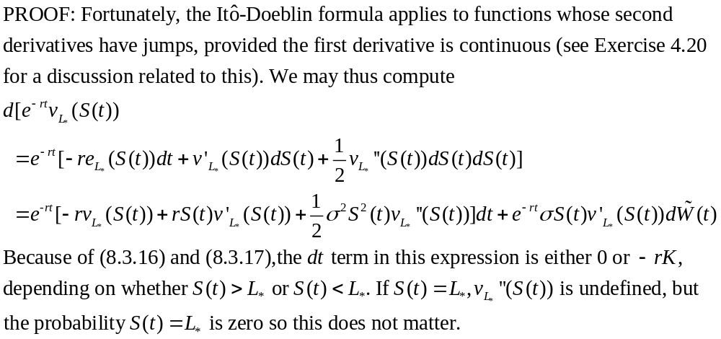
THEOREM 8.3.5

Slide 9
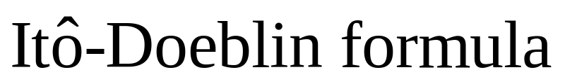
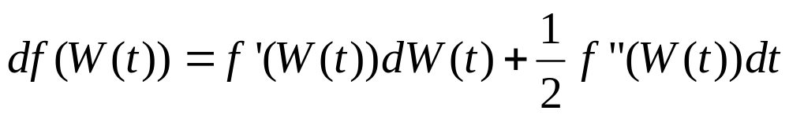
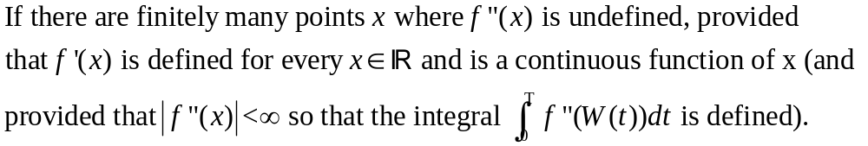
EXERCISE 4.20
Usual assumption:

Slide 10
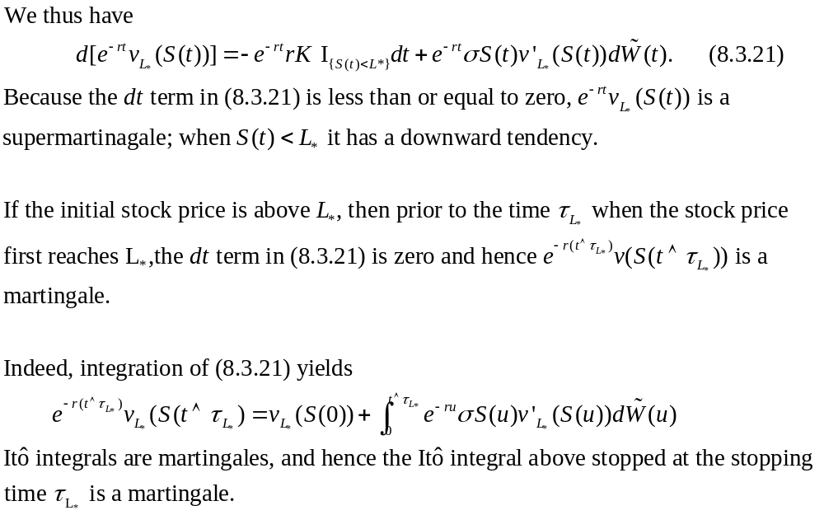

Slide 11
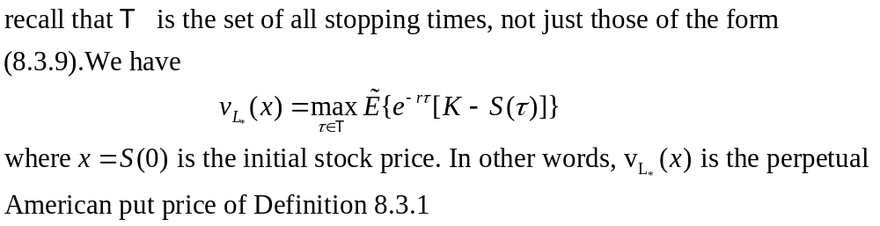
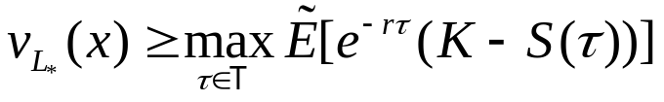
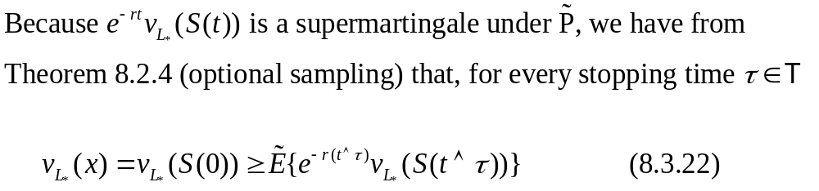
COROLLARY 8.3.6
Proof:
(i)

Slide 12
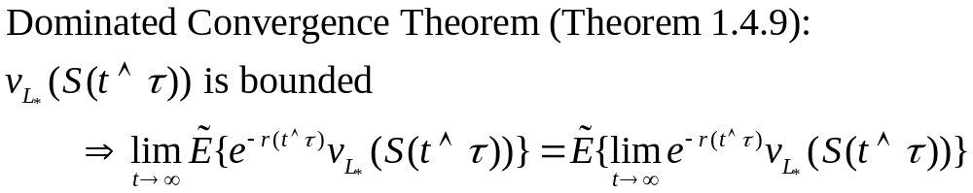
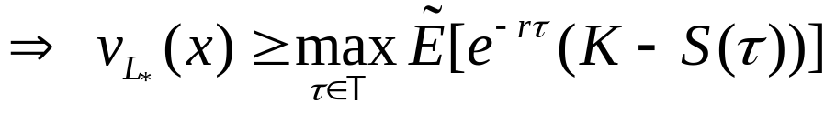

Slide 13
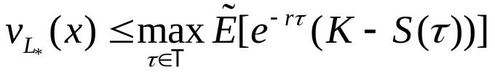
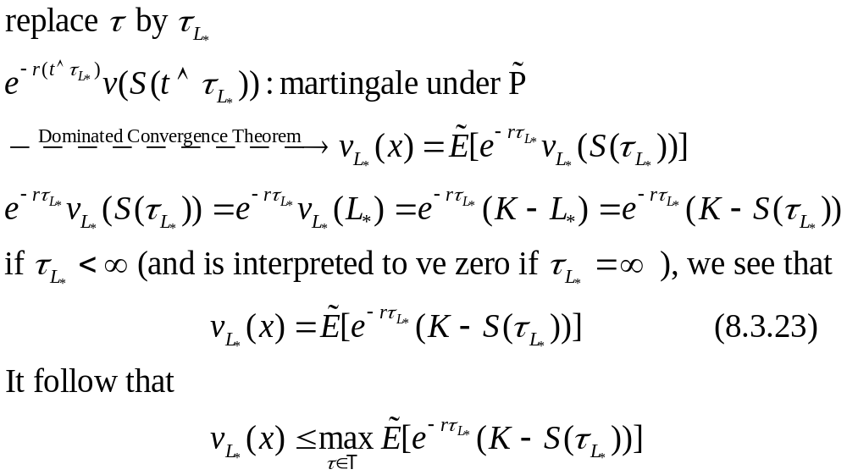
(ii)

Slide 14
Discounted European option prices are martingales under the risk-neutral probability measure. Discounted American option prices are martingales up to the time they should be exercised.
If they are not exercised when they should be, they tend downward.
Since a martingale is a special case of a supermartingale, and processes that tend downward are supermartingales, discounted American option prices are supermartingales.

Slide 15
An agent who is short an American option can hedge that short position in the usual way during the time the discounted option price is a martingale.
If the option is not exercised when it should be, then the agent can continue the hedge and take money off the table.
The following corollary illustrates this for the perpetual American put of this section.

Slide 16
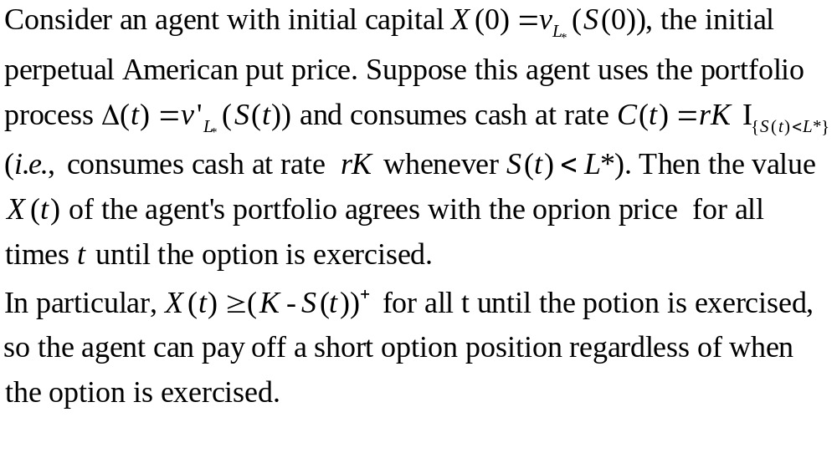
COROLLARY 8.3.7

Slide 17
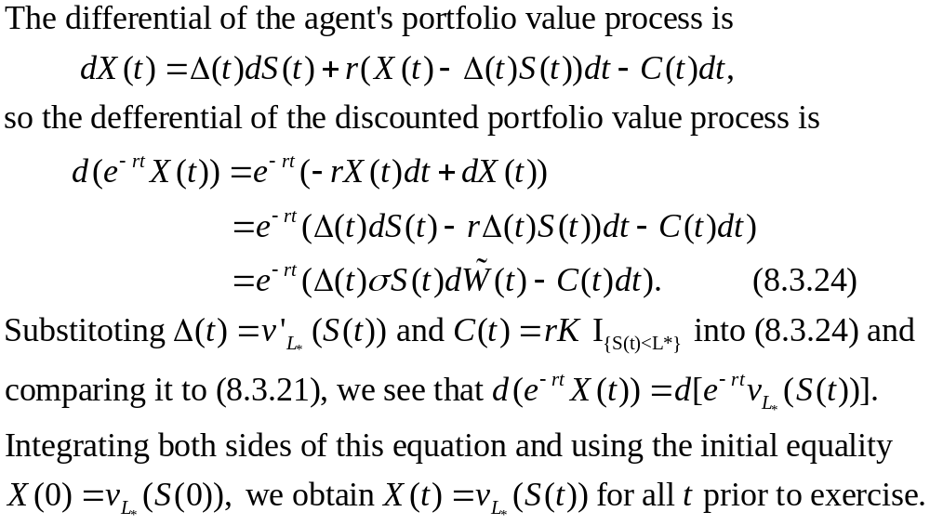
PROOF:

Slide 18
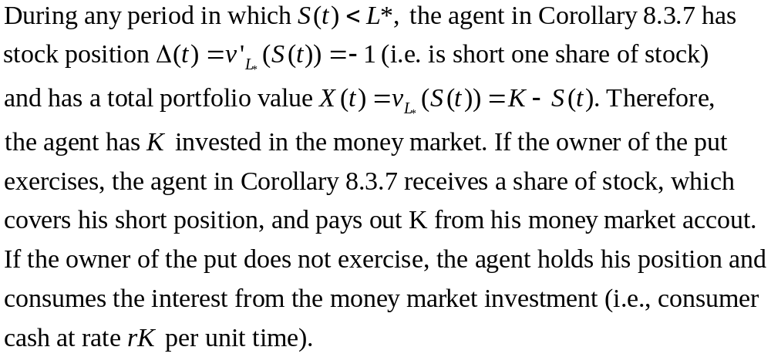
REMARK 8.3.8

Slide 19
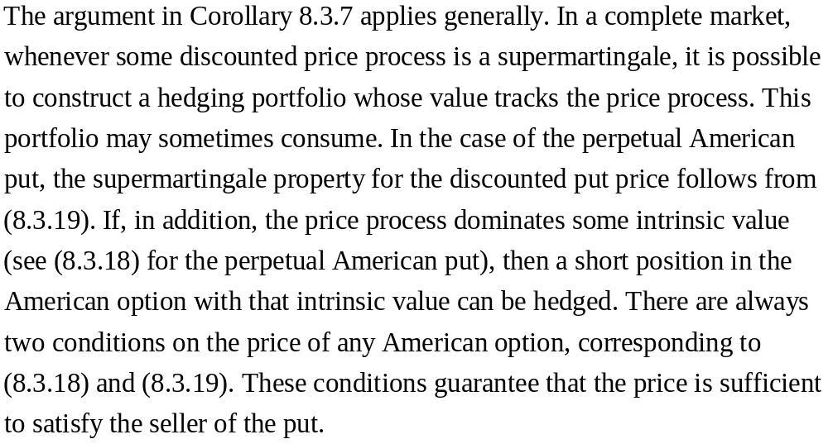

Slide 20
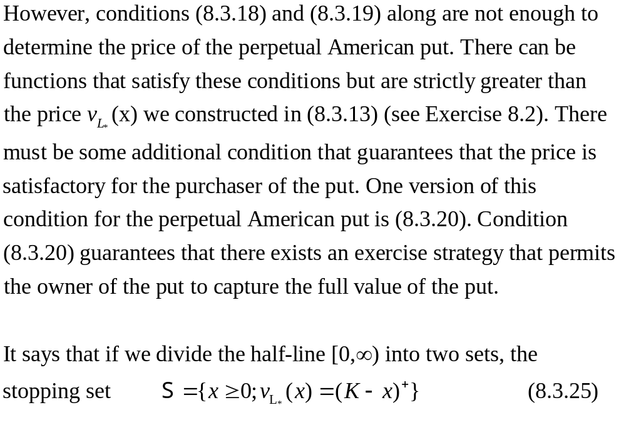

Slide 21
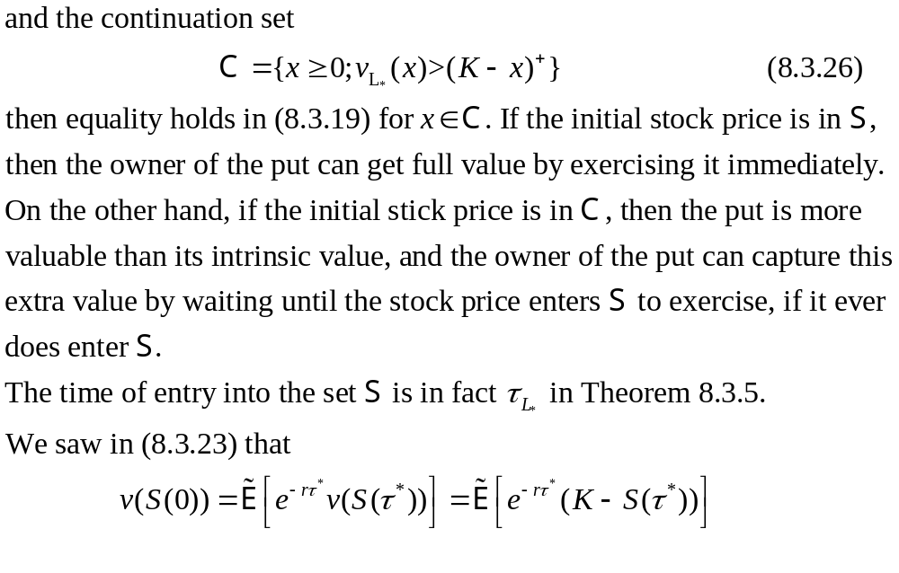

Slide 22
